Slide 1

Check (mate) vulnerabilities! Sebastián Revuelta
Some reflections about OWASP TOP 10 and chess game

Slide 2
Who am I?
Sebastian Revuelta
Security Engineer at Thales Alenia Space
More than 15 years working in software security (and quality)
Application Security: DevSecOps | SAST | SCA | Pentesting
Blog: securingsoftware.blog
Chess player in my childhood
sebastianrevuelta@gmail.com
https://www.linkedin.com/in/sebasrevuelta/

Slide 3
Agenda
Threats in software application security
Owasp top 10
Definition
Example
Solutions
Chess comparisons
OWASP in the software life cycle

Slide 4
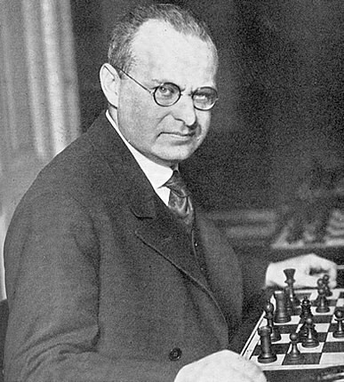
Threats
"The threat is stronger than the execution“ Aaron Nimzowitch (Latvia 1886, chess grandmaster).
We need to keep the tension and do our best all the time to avoid vulnerable points in our system.
Every move should be done to avoid risky points.

Slide 5
Threats
Can we guess/predict threats for our app?
As in a chess game we need to predict the next move of the other player (hacker?).
In software, it happens the same, we need to predict what are the possible threats that can affect our systems.
Threat modeling is like brainstorming of possible moves a hacker can do against our system.
There are different methodologies to follow: STRIDE, CAPEC, Attack Tree, OWASP TOP 10 …

Slide 6
OWASP TOP 10

Slide 7
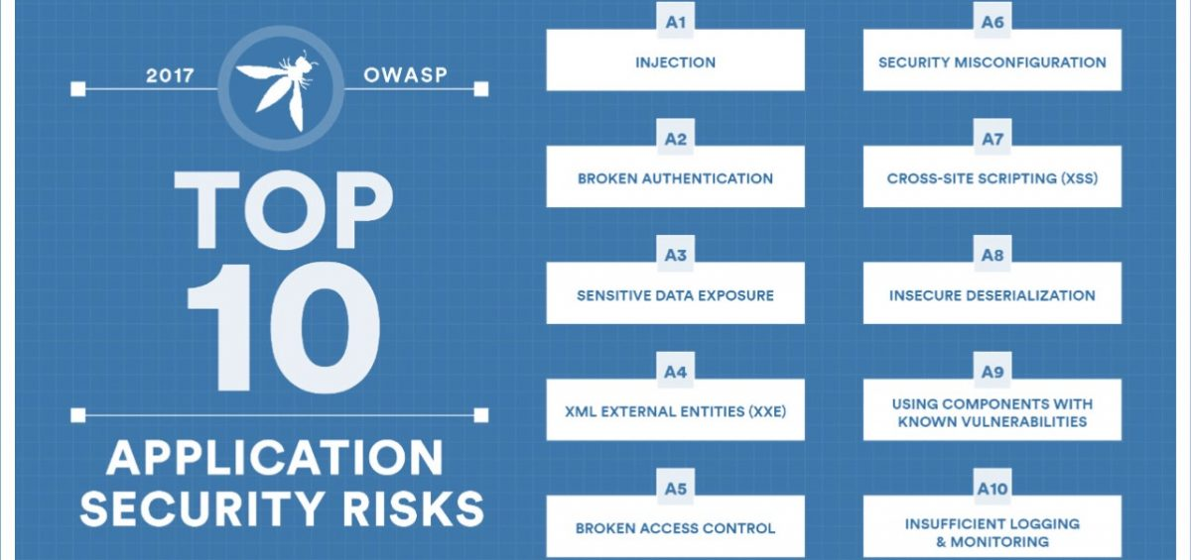
OWASP TOP 10

Slide 8
Injection - Definition
Injection happens when an attacker could insert a payload that is not intercepted by our defence and causes some damage in part of our system.
If the injection affects our database then we talk about SQL Injection.
If the injection affects our logs then we talk about Log Injection.
If the injection executes some commands of our system then we talk about Command Injection.
And there are more injection issues as LDAP injection, XPATH injection.
Front End
Business Logic
bbdd

Slide 9
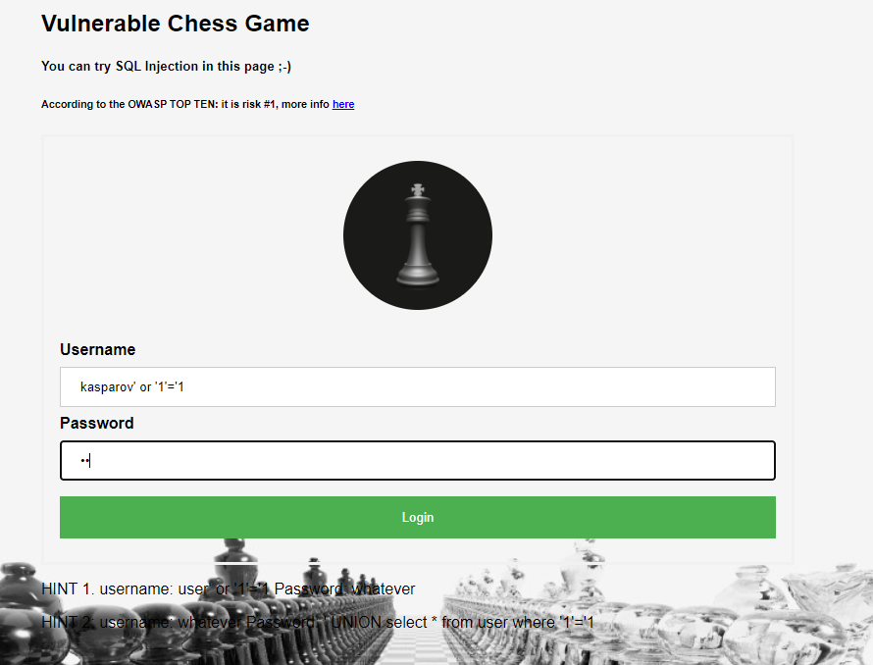
Injection - example

Slide 10
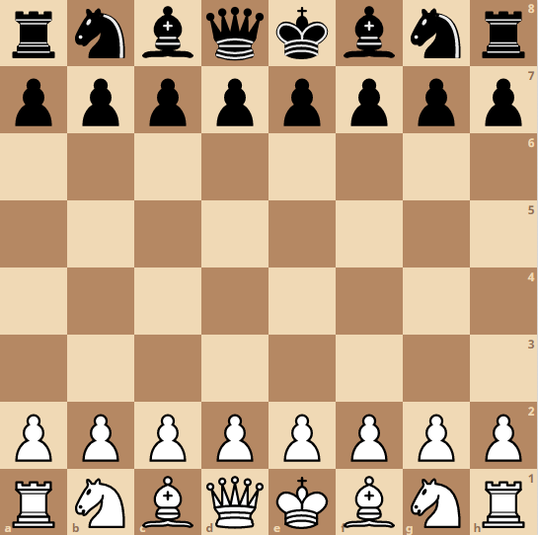
Injection

Slide 11
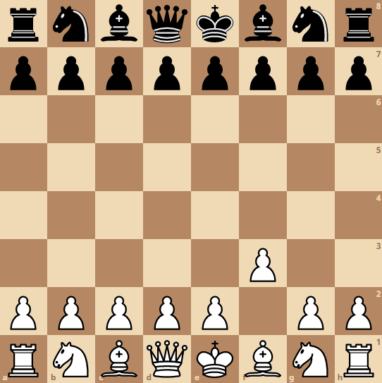
Injection

Slide 12
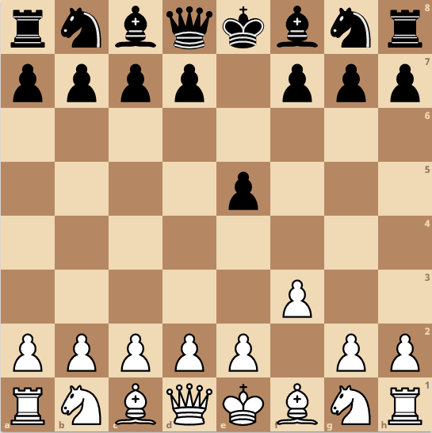
Injection

Slide 13
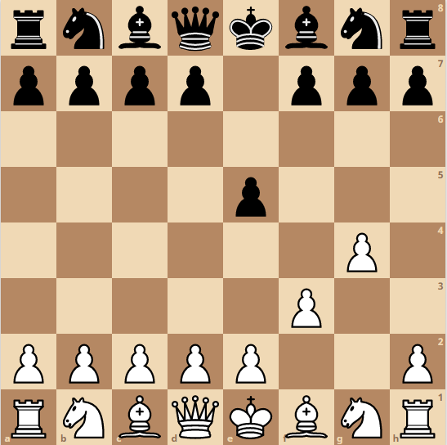
Injection

Slide 14
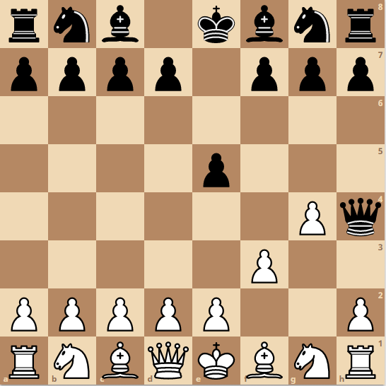
Injection

Slide 15
Injection

Slide 16
Injection: solutions
Validate each input. “Don’t trust in the end user”
Whitelist
Regular expression
String length
Data type
Validate each input. “Don’t trust in the end user”
Whitelist
Regular expression
String length
Data type
Escape characters
Use modern frameworks
Use prepared statements (SQL Injection)
Use stored procedure (SQL Injection)
https://cheatsheetseries.owasp.org/cheatsheets/SQL_Injection_Prevention_Cheat_Sheet.html

Slide 18
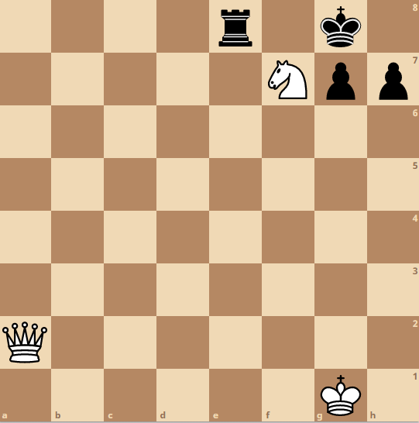
Cross site scripting

Slide 19
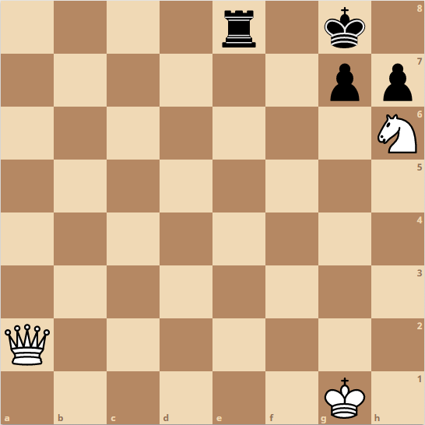
Cross site scripting

Slide 20
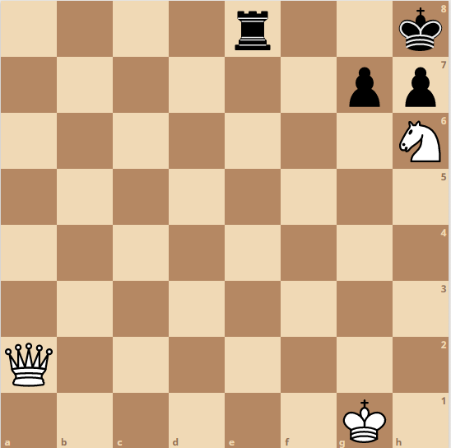
Cross site scripting

Slide 21
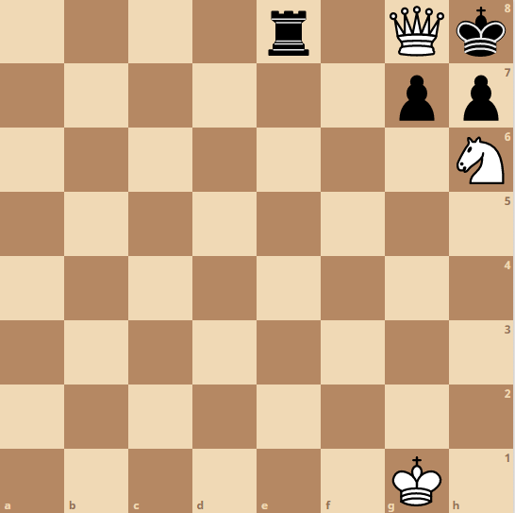
Cross site scripting

Slide 22
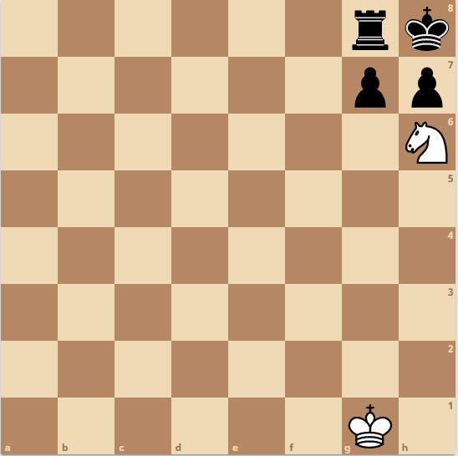
Cross site scripting

Slide 23
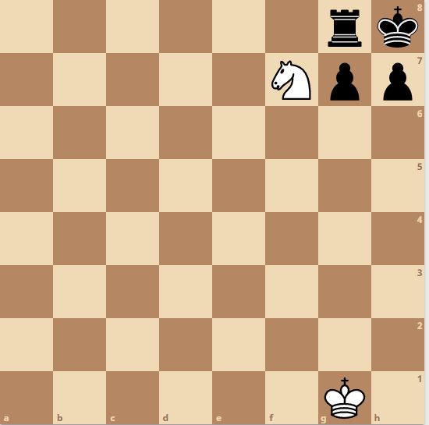
Cross site scripting

Slide 24
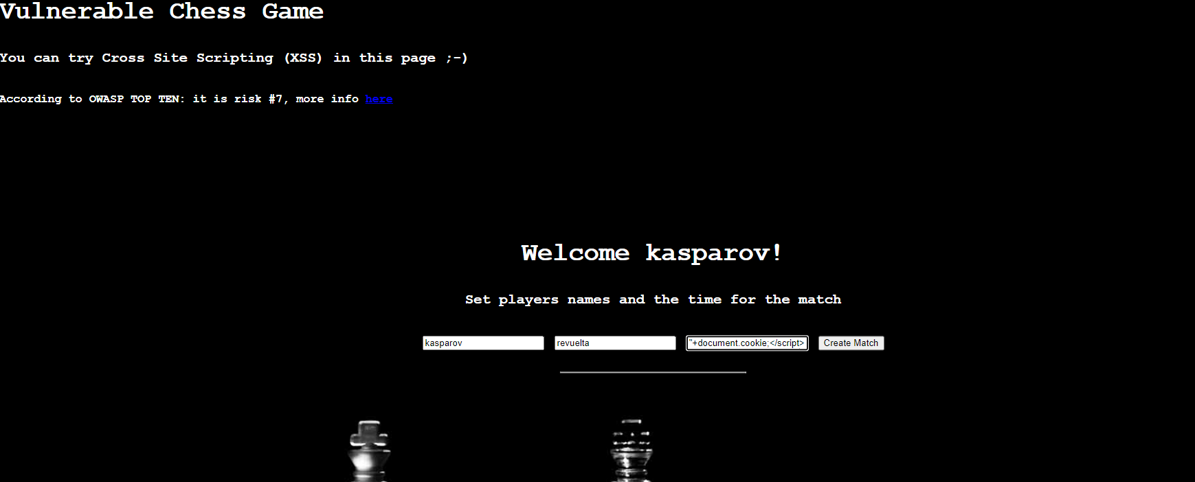
Cross site scripting

Slide 25
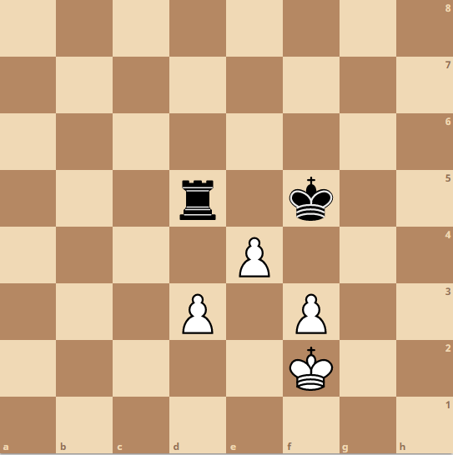
HTTP Response Splitting

Slide 26
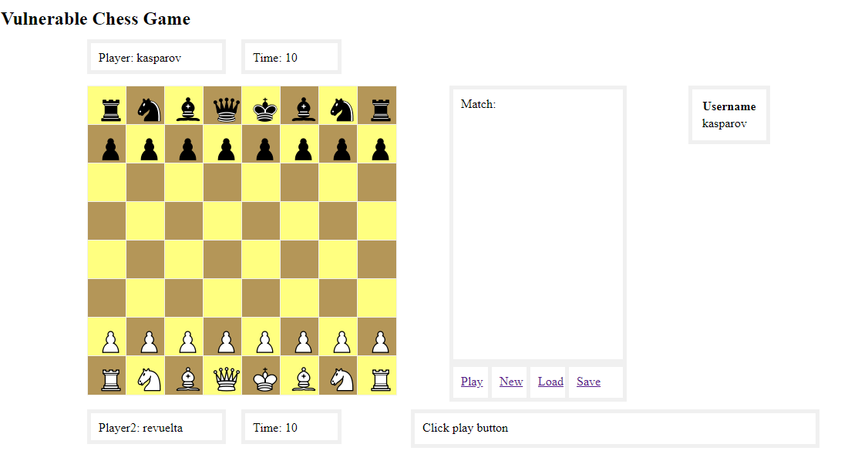
HTTP Response Splitting

Slide 27
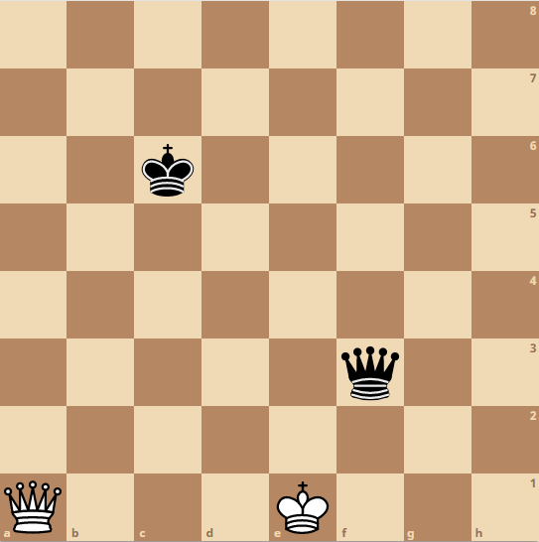
Path Traversal

Slide 28
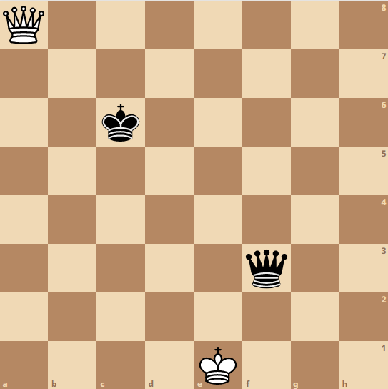
Path Traversal

Slide 29
Path Traversal

Slide 30
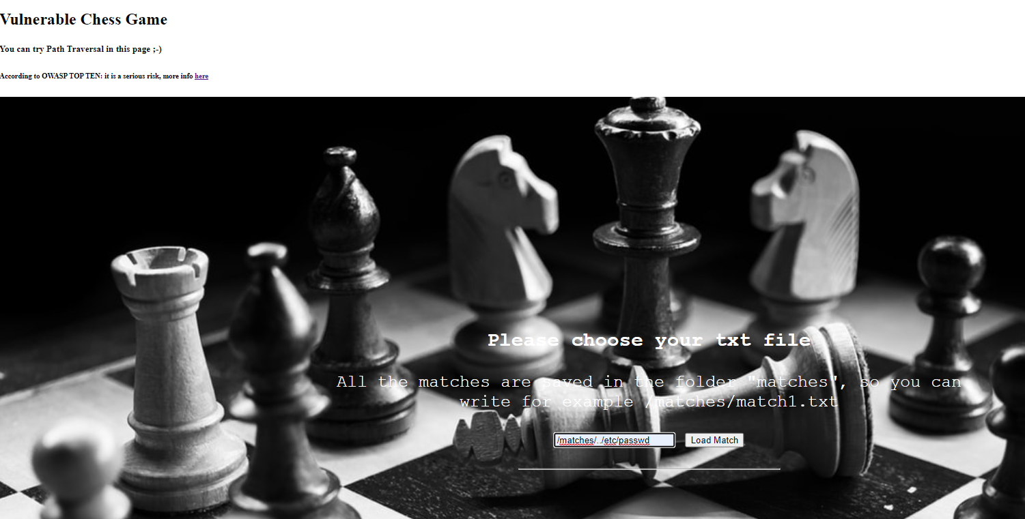
Path Traversal (Demo)

Slide 31
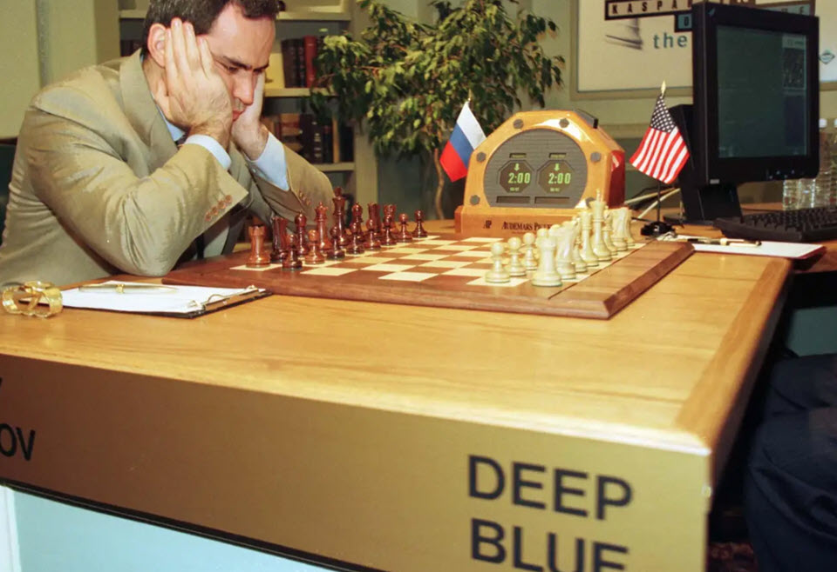
Deep code to win the match
Deep blue was the first machine to win a world chess champion as Kasparov (Nueva York 1997)
We need intelligence machine to win the match against vulnerabilities.

Slide 32
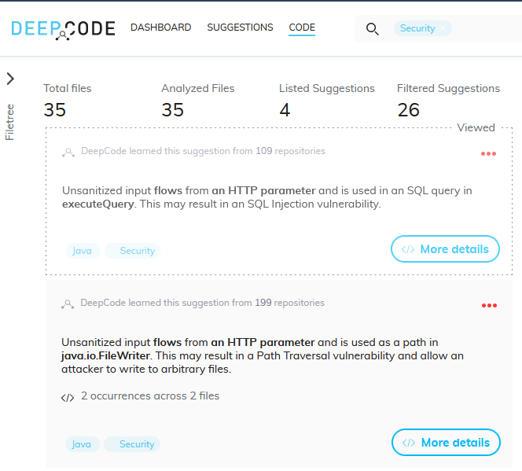
Deep code to win the match

Slide 33
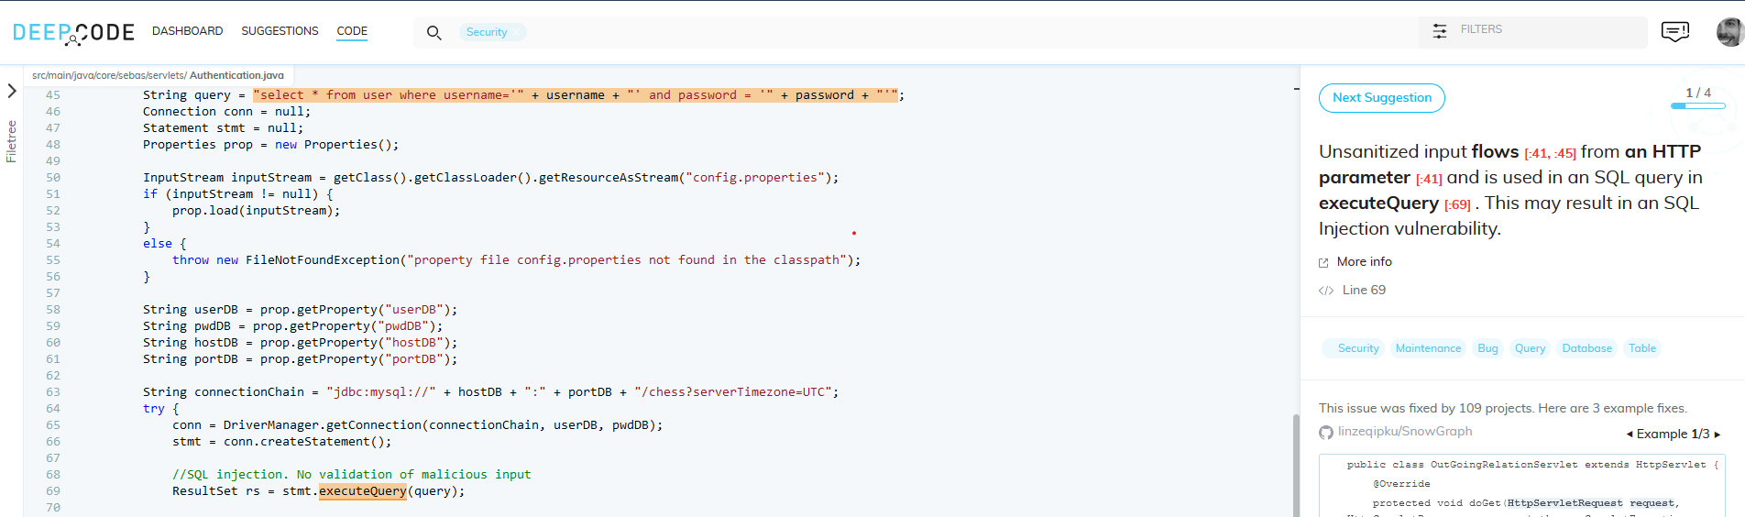
Deep code to win the match

Slide 34
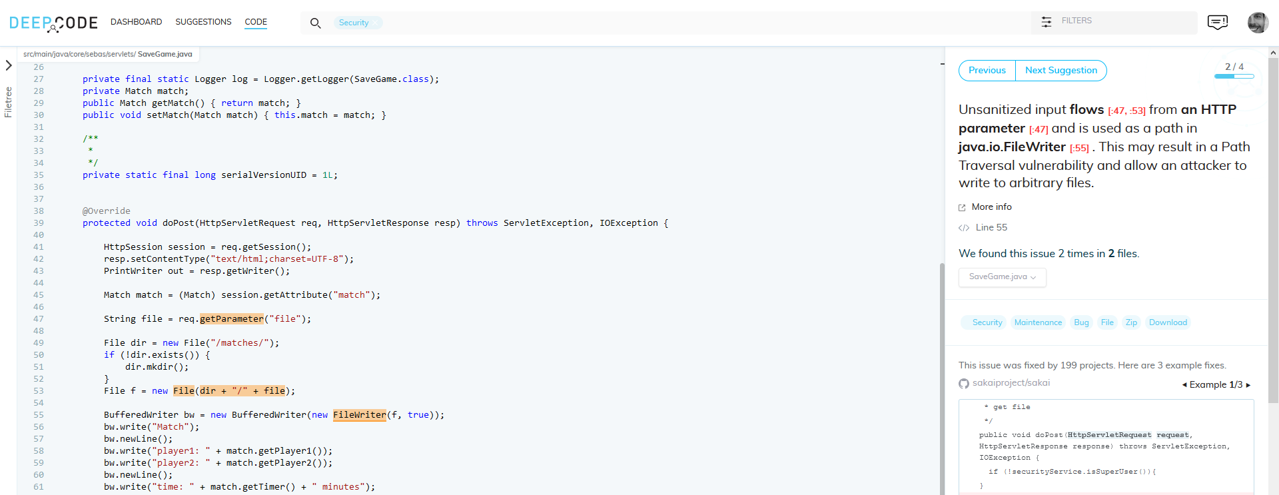
Deep code to win the match

Slide 35
Thanks ++
sebastianrevuelta@gmail.com
https://www.linkedin.com/in/sebasrevuelta/

